Slide 1
Utilizing Meteorological Data with Supervised Learning to Predict Snowfall Amounts at Copper Mountain Ski Resort
Dustin Rapp

Slide 2
Introduction
Prognostic models have difficulty predicting snowfall for specific mountains and slopes
More accurate site specific snowfall forecasts could potentially improve ski resort operations
Copper Mountain unique as multiple official meteorological stations are near or onsite, each with freely available data
Could supervised learning be used to site specific snowfall?

Slide 3
Overview
Outline
Data Utilized
Modeling Methodology
Feature Selection
Model Performance
Model Diagnostics
Recommendations
Goals:
1.) Run a supervised learning model to predict snowfall using readily available meteorological data
2.) Make recommendations based on findings

Slide 4
Surface Data
Station ID | Station Type | Location | Elevation | Meteorological Measurements Utilized | Temporal Resolution
SNOTEL 415 | NRCS SNOTEL | Popular Ski Runs midway up Copper Mtn | 10550’ | Temperature Snow Depth | Hourly
KLXV | NWS ASOS | ~25 mi SW of Copper Mtn | 9938’ | Temperature Dewpoint Wind Speed Wind Direction Pressure 12-hr Pressure Changes* | Hourly
KCCU | CDOT AWOS | Near top of Copper Mtn | 12075’ | Temperature Dewpoint Wind Speed Wind Direction | Hourly
*Calculated feature

Slide 5
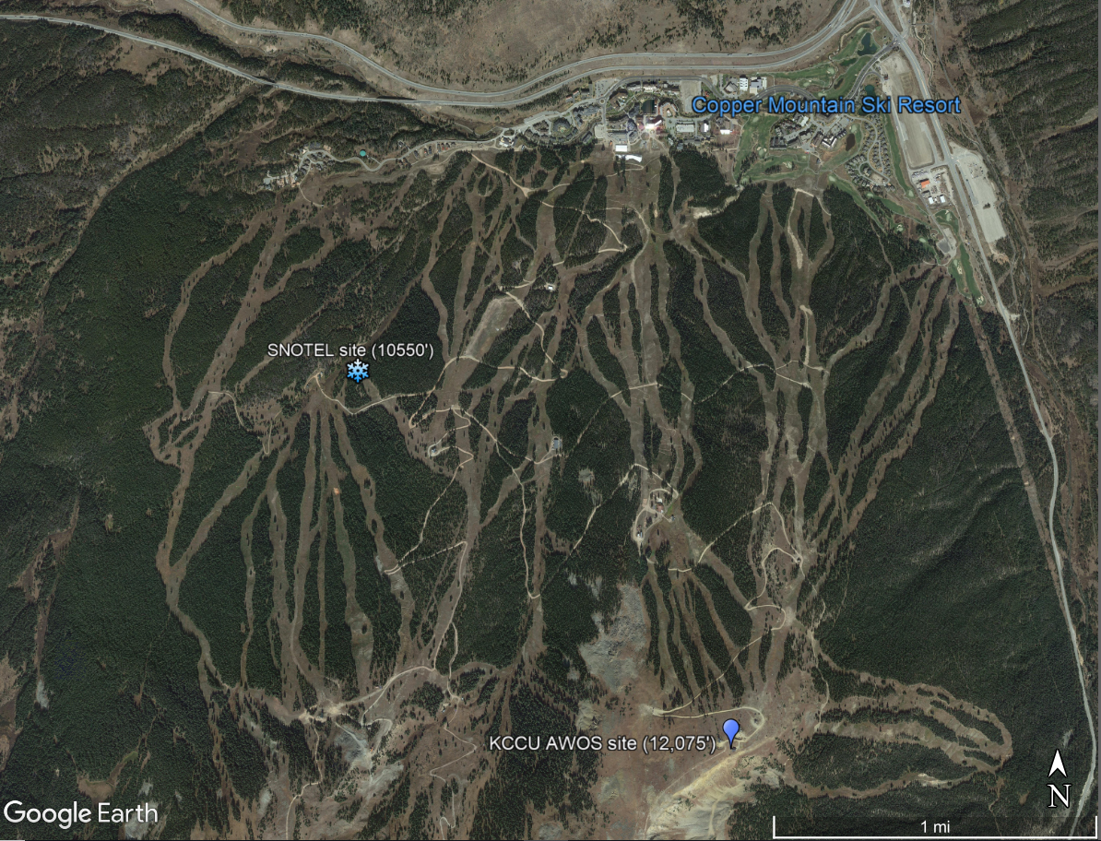
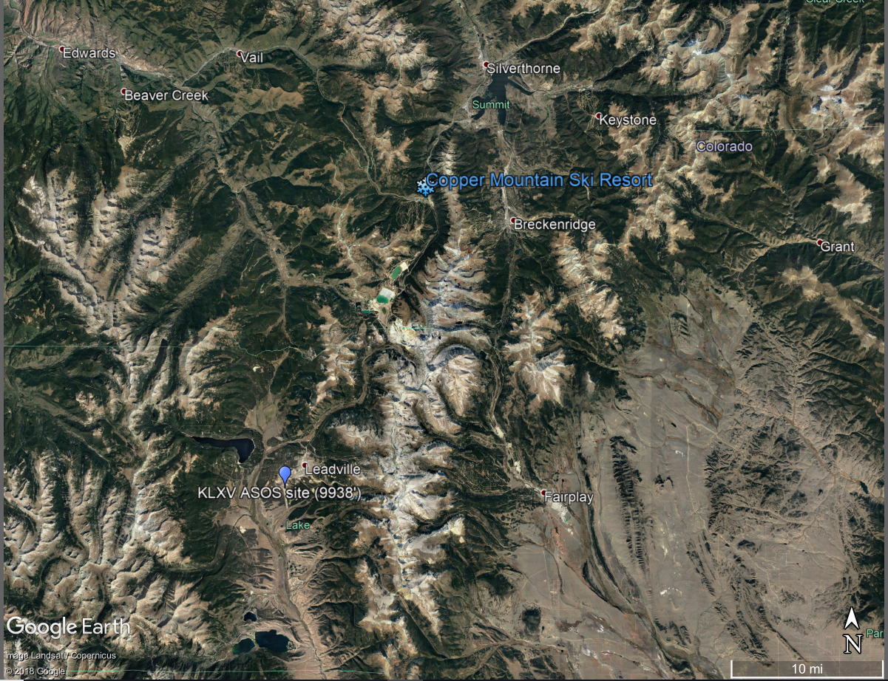
Surface Data Monitor Locations

Slide 6
Additional Upper Air Data
Snowfall is highly dependent on physics of crystal development, which is affected by upper air physics. Therefore, upper air data was also included
Station ID | Location | Pressure Levels | Measurements at each Level | Temporal Location
KJCT | Grand Junction, CO | 200mb, 250mb, 300mb, 400mb, 500mb, 700mb, & 850mb | Height Temperature Dewpoint Wind Speed Wind Direction | 12 hour
Differences in meteorological measurements between Pressure Levels are common considerations when forecasting snowaffall so were also calculated and included (e.g. 500mb Dewpoint minus 400mb Dewpoint) as additional features

Slide 7
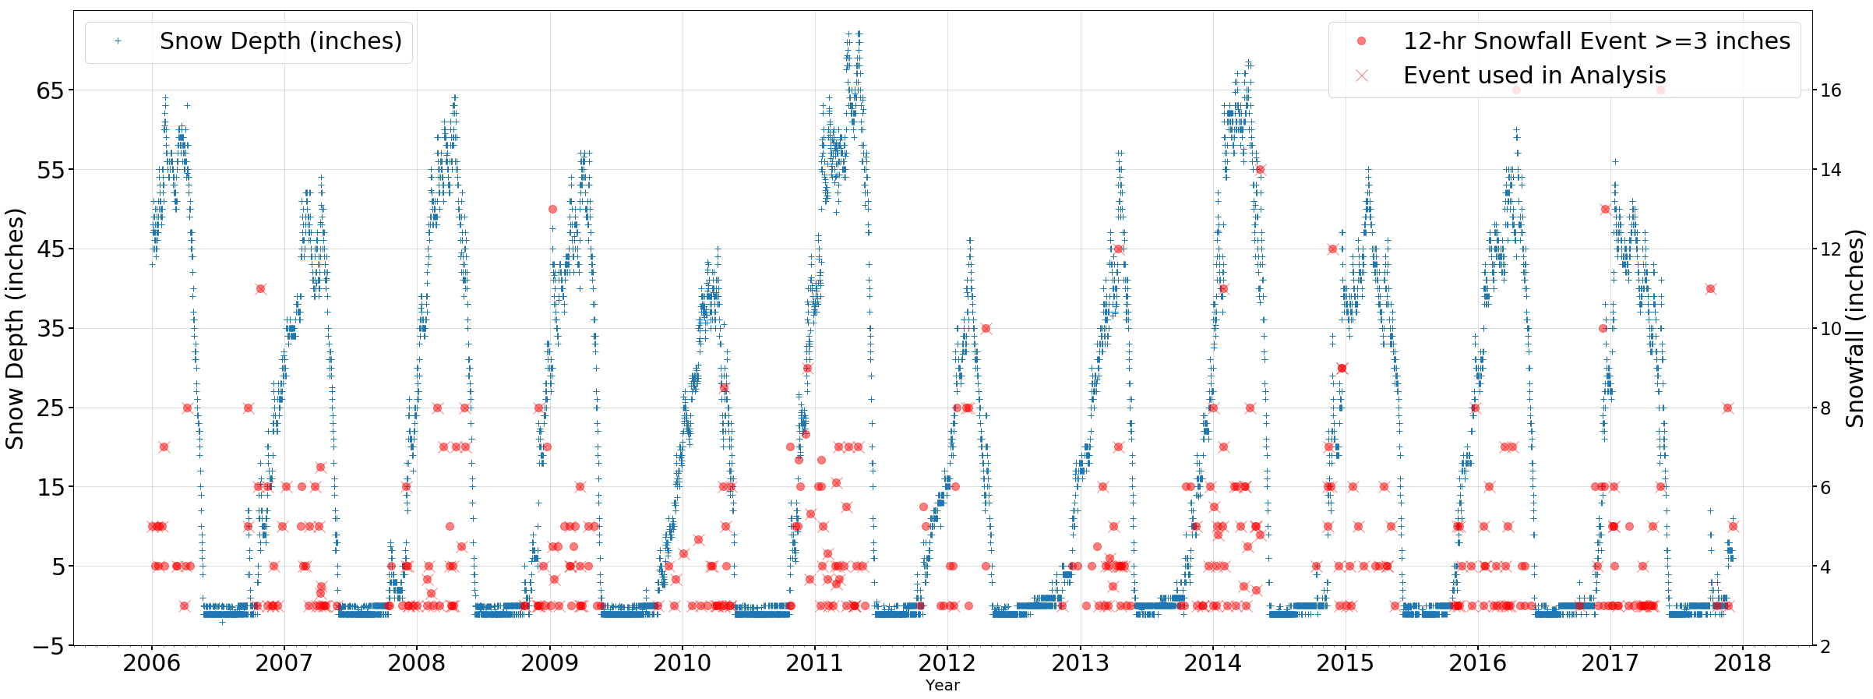
Snowfall vs Snow Depth
SNOTEL stations report snow depth. Snowfall was calculated.
12-hr snowfall only. Events >=3” due to noise in data.

Slide 8
Modeling Methodology
Ordinary Least Squares (OLS) model chosen as most basic supervised learning approach
Linear Regression Analysis performed for all features
Datasets divided into two Training/Test partitions
Features for use in model chosen using forward stepwise approach
Two model runs were fit on each of the two training partitions:
Surface Data Feature Only
Surface Data plus Upper Air Data Features
Fitted models were then tested on respective test datasets to assess snowfall prediction

Slide 9
Test/Training Partitions
Two partitions were developed as two modeling scenarios would give better assessment of real world model performance
Priority was given to preserve seasonality in test/train set by choosing full year groupings which resulted 80/20 splits
Partition A:
Test set: Years 2015, 2016 and 2017
Train Set: Remaining Years 2006-2014
Partition B
Test Set: Years 2013 and 2014
Train Set: Remaining years - 2006-2012, 2015-2017
Each of the these divisions resulted in ~80% Training/~20% Test Datasets

Slide 10
Feature Selection
Statsmodel using forward stepwise approach on Training Datasets
Adjusted R² used as metric
Optimized such that individual feature t-statistic confidence intervals (p values) were minimized
Upper Air Data did improve Adjusted R²
Partition A – Best Combination of Features
Dataset | Adj. R-squared: | F-statistic: | Prob (F-statistic)
Surface Data Only | 0.045 | 2.818 | 0.0177
Surface+Upper Air Data | 0.189 | 3.493 | 8.73e-06
Partition B – Best Combination of Features
Dataset | Adj. R-squared: | F-statistic: | Prob (F-statistic):
Surface Data Only | 0.100 | 5.309 | 0.000137
Surface+Upper Air Data | 0.303 | 1.38e-09 | 0.000229

Slide 11

Model Performance of Snowfall Predictions
Model | Sci-kit R2 Score | RMSE (inches)
Partition A (Surface Data Features only) | 0.018 | 2.392
Partition A (Surface+Upper Air Data Features) | 0.052 | 2.35
Partition B (Surface Data Features only) | -0.164 | 2.622
Partition B Surface+Upper Air Data Features) | -0.293 | 2.764
Partition A model performed better then Partition B model
The Partition B models performed very poorly by all metrics
Upper Air Data did improve performance in the Partition A cases.
Why such bad performance for Partition B??
Much room for improvement! But many opportunities..

Slide 12
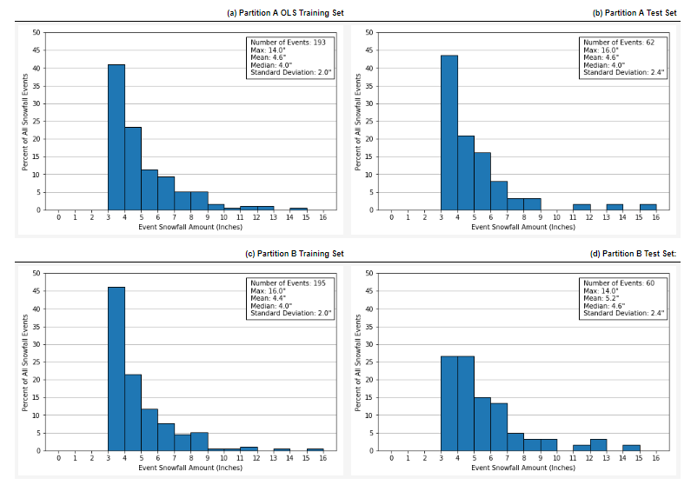
Snowfall Distributions between Training and Test Set
Partition B Test and Training set snowfall distributions very different, likely causing poor performance
Both Partition A Test/Train sets are heavily weighted by lighter snowfall – may tend to underpredict higher snowfall events.

Slide 13
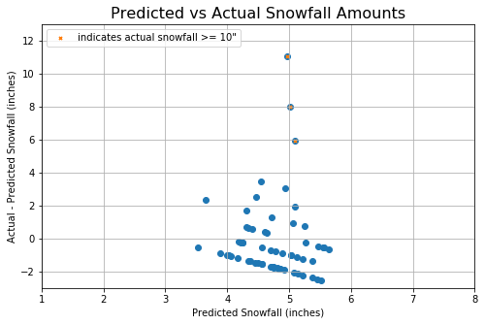
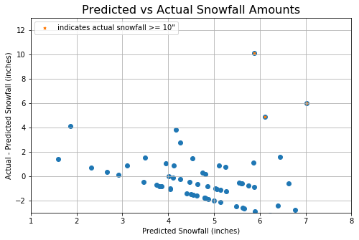
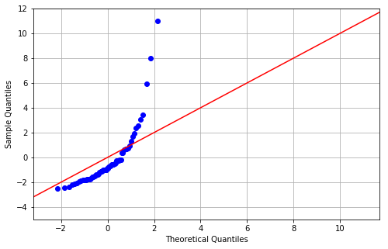
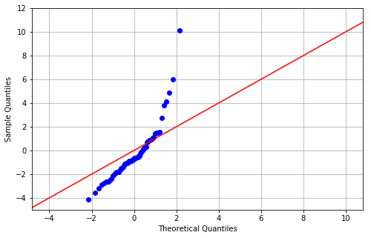
Upper Air Data Inclusion (Partition A)
Surface Data Only
Surface+Upper Air Data
Large number of smaller snowfall events in training set caused lower underpredictions in higher snowfalls
Despite large number of small snowfall events, upper air data did improve predictions of these events

Slide 14
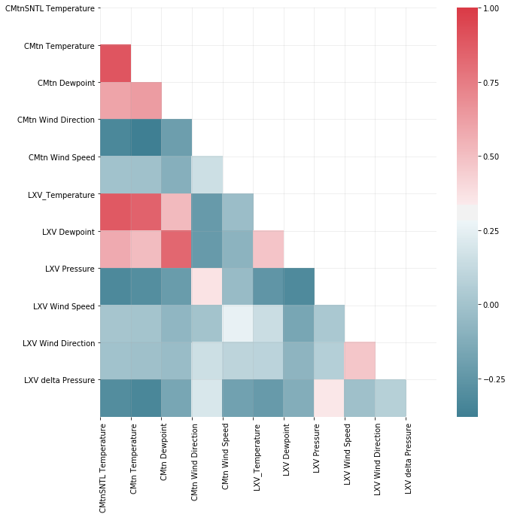
Multicollinearity and Non-linear features
Multicollinearity
Due to proximity, temperature trends between sites were similar
In upper air data, heights were strongly correlated.
Non-linear features
Though there was found to be predictive capability, Wind Direction is by nature not a linear variable and may not be beneficial in all cases, especially when winds are more northerly.
Likely negatively influencing model

Slide 15
Non-linearity considerations
Sometimes 1” of melted can equate up to a foot of snow. Finer snow could result in two feet or more
Snowfall must consider temperatures where the snow develops (upper air), as well as amount of moisture available.
Breaking model down into finer components (e.g. try to predict amount of moisture to fall vs snowfall) may be better approach

Slide 16
Major Recommendations
The top three recommendations to improve performance are:
Investigate collinear features more, and consider eliminating some of the strongly collinear features
Work to balance the distribution of snowfall event sizes in the training sets to improve prediction of larger snowfall events.
Consider breaking complexity of model by predicting only the amount of moisture that is expected to fall at first - then add additional complexity of snow depth.

Slide 17
Acknowledgements
Thanks to Dr. Guy Maskall of Springboard for mentorship during the preparation of this analysis

